Slide 1
Lighting & Landscape for Security
Manor Country Club Community Association

Slide 2
Landscaping and Lighting Deter Crime and Increase Home Value
An important part of home security is proper landscaping and exterior lighting. Done correctly both have been shown to deter crime.
In addition, if done properly well designed landscaping and lighting will increase the value of you home.

Slide 3
Well-Designed Landscaping
Enhances the beauty, value and appearance of a house
Realtors and numerous studies have shown well designed landscaping adds to the value of a home and buyers are attracted to well landscaped homes.
Trim the landscaping and prevent a crime
A study from Tulane University indicated an ideal target for a criminal is a house surrounded by large hedges and shrubs, because they block visibility from the street and neighbors’ homes.
Removing or trimming overgrown landscaping particularly at windows and eliminates hiding places. Combined with proper lighting proper landscaping aids as a deterrence for potential burglars.
Increase visibility by trimming all bushes and hedges to 3 feet or shorter to allow increased visibility for your neighbors, who can report fishy activity.

Slide 4
Well-Designed Lighting
Enhances the beauty, value and appearance of a house
A number of studies have shown that most home and property owners prefer a home with a well designed, house and landscape lighting system. Taking these steps can make your home increase 20% in value.
Prevents crime
An American and British study showed that improved lighting leads to increased surveillance of potential offenders and aids as a deterrence for potential offenders. The study also revealed that improved lighting signals community investment and improvement, leading to increased community pride.

Slide 5
Different Lighting Sources
Incandescent
Fluorescent
Light Emitting Diode (LED)

Slide 6
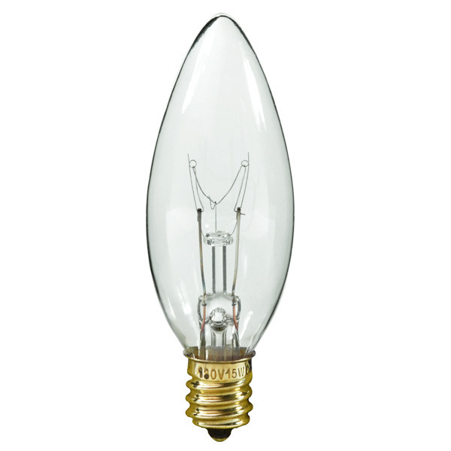
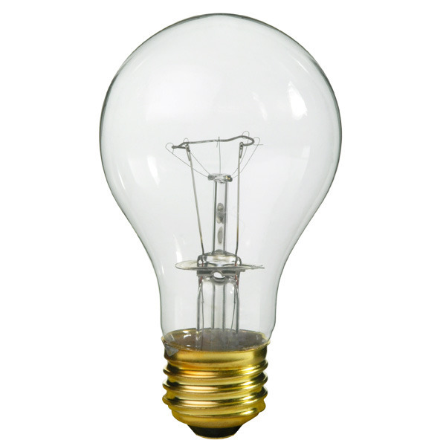
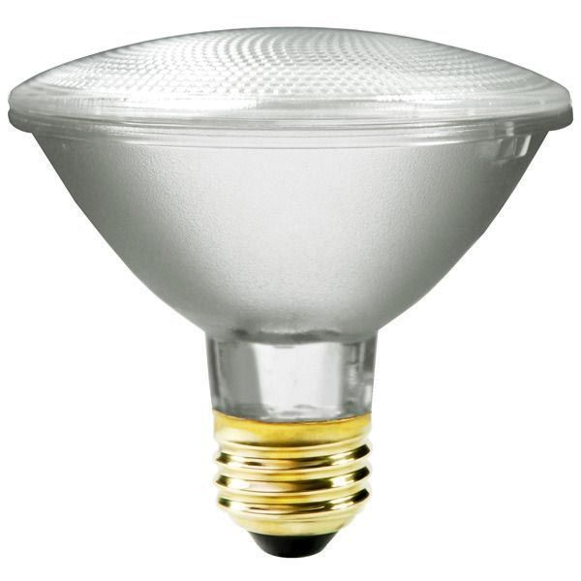
Incandescent
Original electric light source
Various functions
General Lighting
Spot Lighting
Flood Lighting
Low initial cost
High energy cost
Lasts 1,000 hours
Environmentally friendly

Slide 7
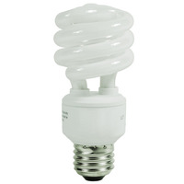
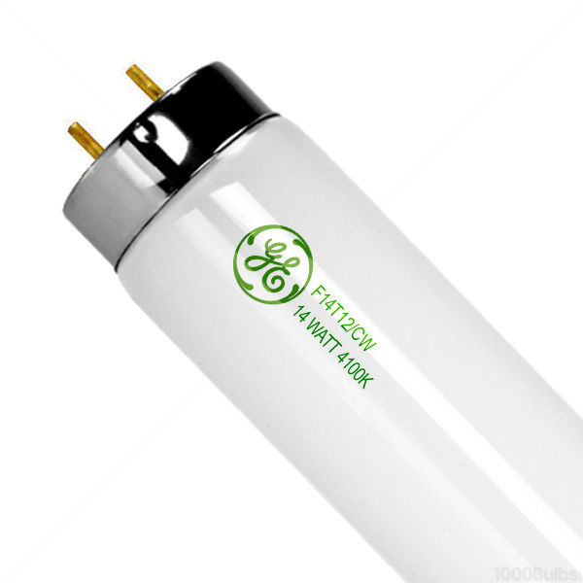
Fluorescent
Various functions
General Lighting
Flood Lighting
Moderate initial cost
Moderate energy cost
Lasts 10,000 hours
Not environmentally friendly -
Contains mercury

Slide 8
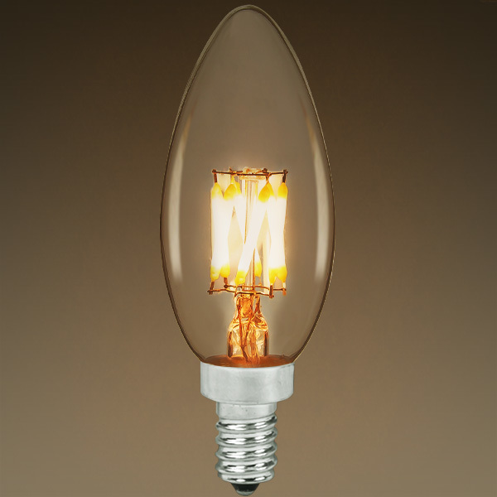
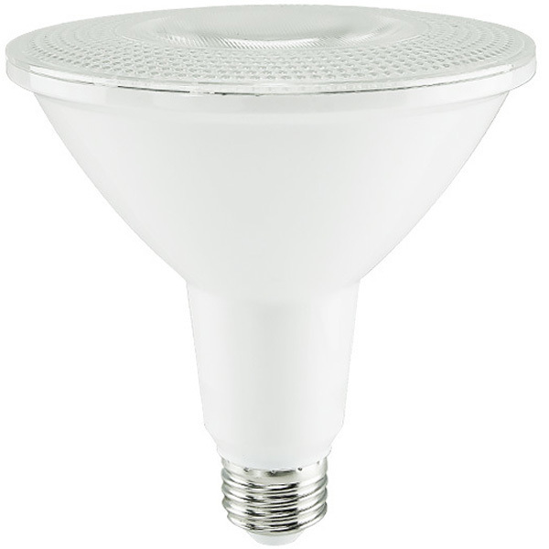
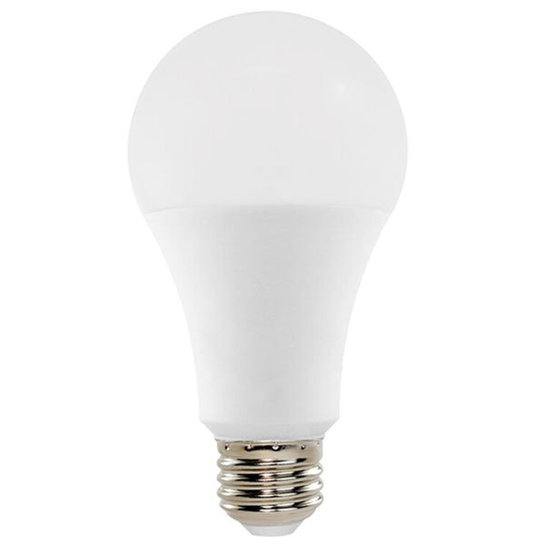
LED
Solid State Light Source
Various functions
General Lighting
Spot Lighting
Flood Lighting
Moderate initial cost
Low energy cost
Lasts 20,000 to 25,000 hours
Environmentally friendly

Slide 9
LED Advantage: Energy Cost
Cost less to operate reducing energy costs
Incandescent $79 per year for 150 watts
Fluorescent $33 per year for 64 watts
LED $11 per year for 21 watts

Slide 10
LED Advantage: Last Longer
Last longer reducing cost to replace
Incandescent 1,000 hours (1/2 a year)
Fluorescent 10,000 hours (5 years)
LED 25,000 hours (22 ½ years)

Slide 11
LEDs can have internal controls or features
Automatically turn on at dusk and off at dawn
Come on when an intruder is detected
Have integrated cameras in the light
Change color
Dim

Slide 12
Different Approaches for LEDs
Retrofitting using the existing fixture
Replace the fixture

Slide 13
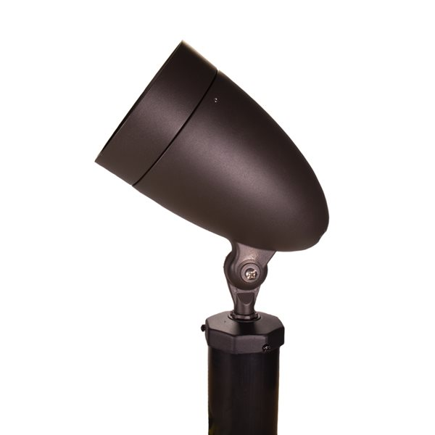
Retrofit vs. Replace
Existing fixture
New Fixture

Slide 14
How to select a LED
Size-Confirm the size is the same as what is being replaced
Equivalent wattage-Manufacturer provides information
Lumens
Color of light

Slide 15
LED think Lumens not Watts

Slide 16
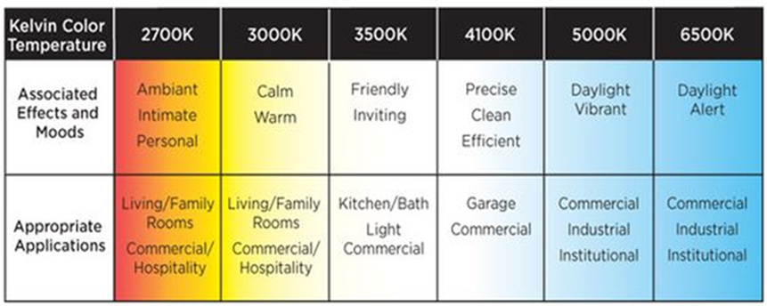
LED Select the Color of Light

Slide 17
LED Check the Light Bulb Size

Slide 18
LED Lighting Label

Slide 19
Camera With Integrated Light
Internal light provides light for the camera to see and record activity where the camera is focused.

Slide 20
Places to Purchase Light Bulbs & Fixtures
Local Hardware Stores:
Home Depot, Lowes, White’s Hardware, Strosniders, Christopher’s
Internet:
1000 Bulbs www.1000bulbs.com
Superior Lighting www.superiorlighting.com
Bulbs.com www.bulbs.com
SuperBriteLEDs.com www.superbrightleds.com

Slide 21
Design and Installation Companies
Outdoor Illumination, Inc. Bethesda, MD (301) 907-4999
Atlantic Lighting & Irrigation Co Gambrills, MD (410) 721-4070
Outdoor Lighting Perspectives of DC Metro Washington, DC
(202) 888-2718
Enlightened Lighting, LLC Sterling, VA (703) 520-5021
Olsen Weaver LLC Alexandria VA 703-881-1841

Slide 22
Pepco Lighting Rebates
Lighting Program Guidelines:
Limit 25 LED bulbs per customer.
Limit 6 light fixtures per customer.
For more information on Pepco's Lighting Program, call 1-866-353-5798 or homeenergysavings.pepco.com/lighting-program

